Slide 1
Dr. Sunirmal Khatua
Cellular Networks : GSM(2G)
Presented By
Visvesvaraya Young Faculty Fellow, Govt. of India
Assistant Professor, University of Calcutta
Notes:
We celebrate Christmas to remember the birth of Jesus Christ

Slide 2
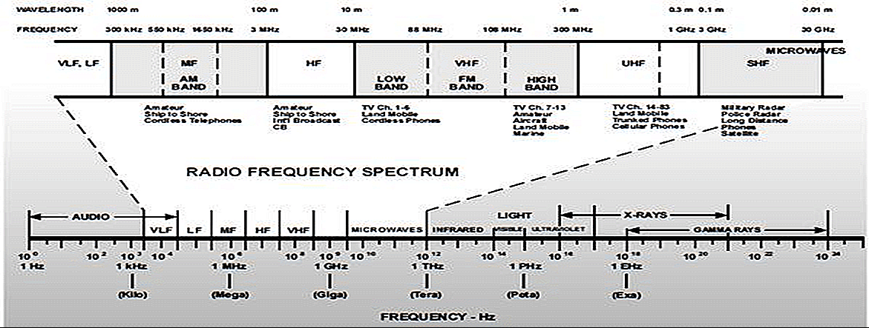
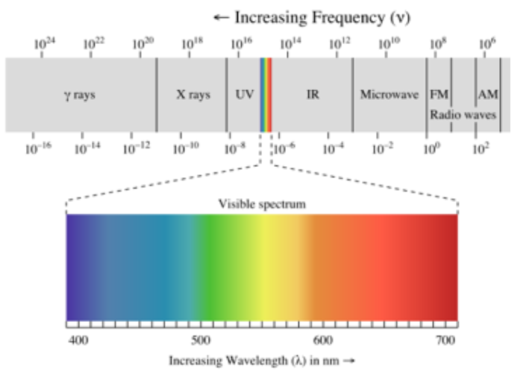
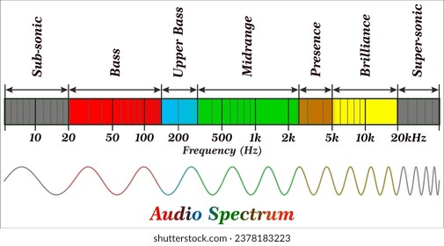
Useful Spectrum

Slide 3
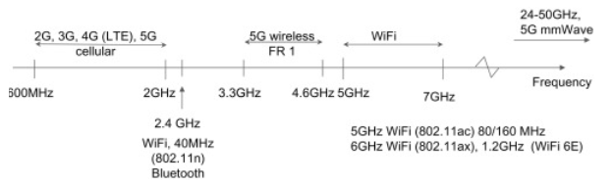
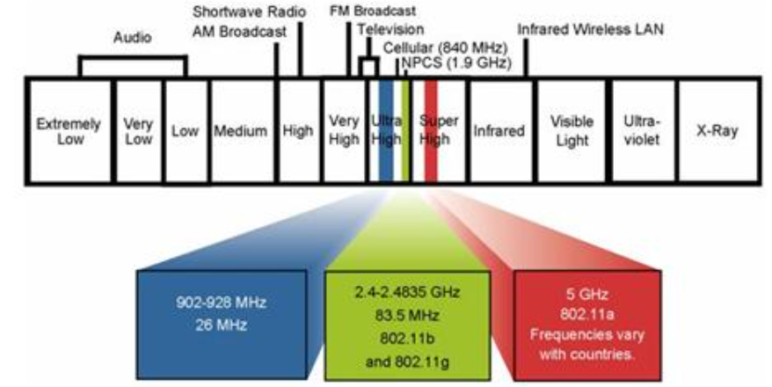
Radio Spectrum

Slide 4
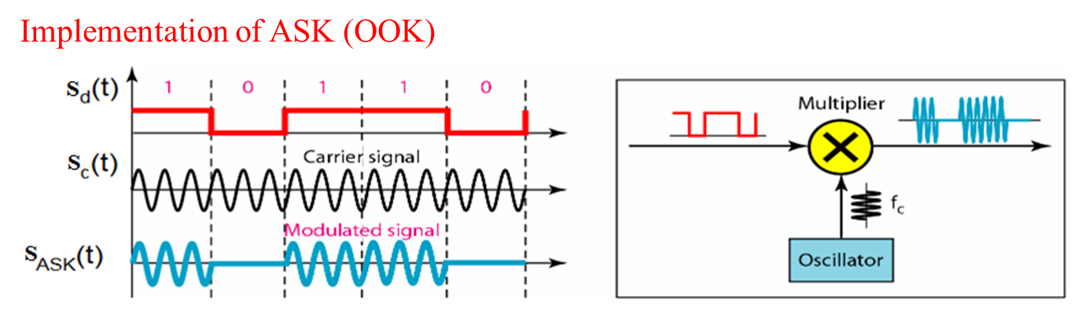
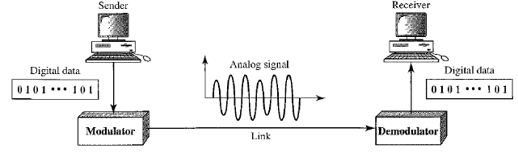
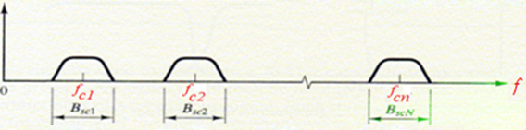





Constraint of Frequency in a Spectrum

Slide 5
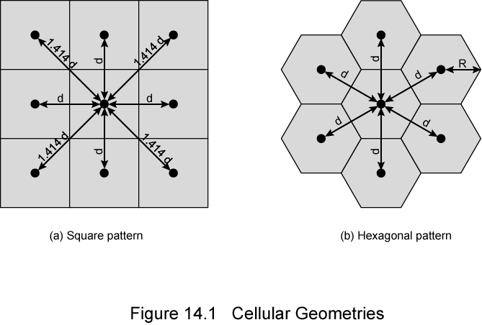
Frequency Allocation in Cellular Networks
GSM 900 uses 2 Frequency Bands of 25MHz.
890-915MHz for UPLINK and 935-960 MHz for DOWNLINK
Each Band provides 125 Carrier of 200KHz each. 1 Carrier is provided as a Guard Channel
between GSM and Other Bands.

Slide 6
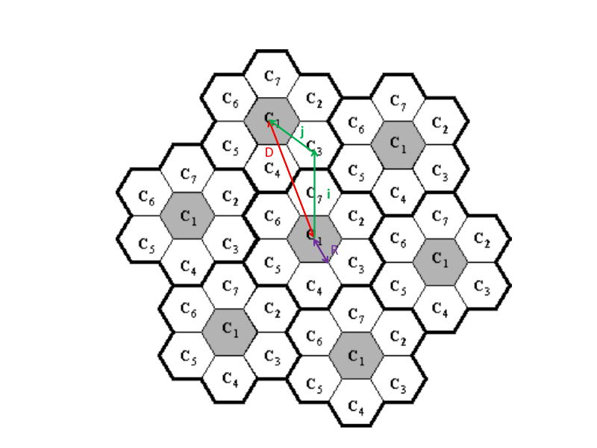
Reuse the Frequencies
Cluster
1 set of Frequencies
GSM 900 uses 2 Frequency Bands of 25MHz.
890-915MHz for UPLINK and 935-960 MHz for DOWNLINK
Each Band provides 125 Carrier of 200KHz each. 1 Carrier is provided as a Guard Channel
between GSM and Other Bands.

Slide 7
Reuse the Frequencies
Frequency Reuse Algorithm
Starting from any cell A, move i cells along one direction.
Turn anticlockwise 60 degrees, then move j cells in the direction
Assign the same frequency to this cell
Starting from A , repeat for another direction, until all directions are covered.
Note : i and j determines the cluster size, N
here N = 7, i = 2, j = 1
Cluster
1 set of Frequencies
GSM 900 uses 2 Frequency Bands of 25MHz.
890-915MHz for UPLINK and 935-960 MHz for DOWNLINK
Each Band provides 125 Carrier of 200KHz each. 1 Carrier is provided as a Guard Channel
between GSM and Other Bands.

Slide 8
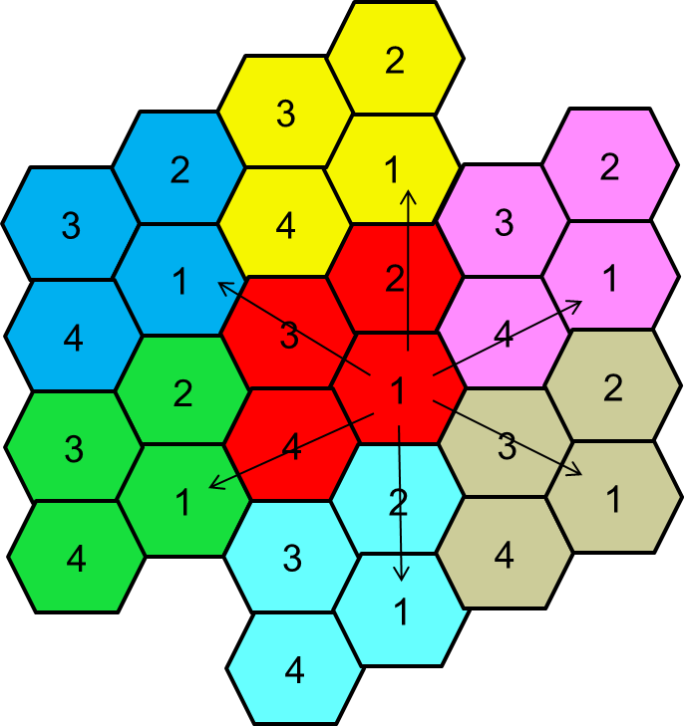
Reuse the Frequencies
Frequency Reuse Algorithm
Starting from any cell A, move i cells along one direction.
Turn anticlockwise 60 degrees, then move j cells in the direction
Assign the same frequency to this cell
Starting from A , repeat for another direction, until all directions are covered.
Note : i and j determines the cluster size, N
here N = 7, i = 2, j = 1
N = 4, i = 2, j = 0

Slide 9
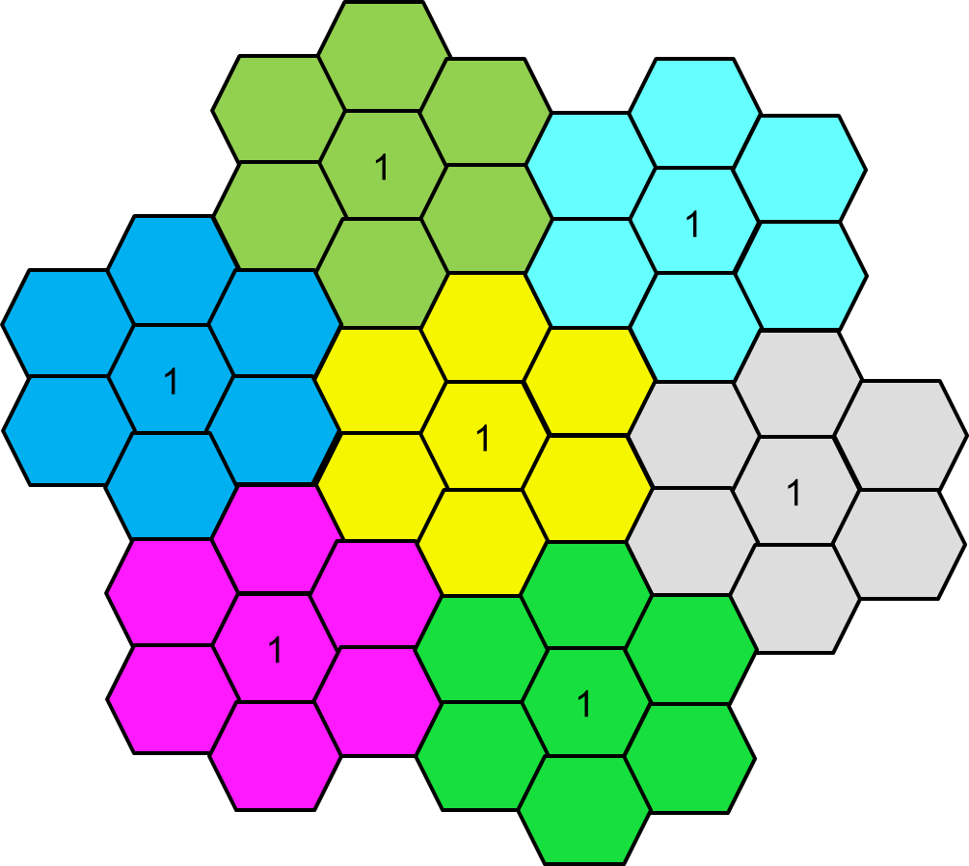
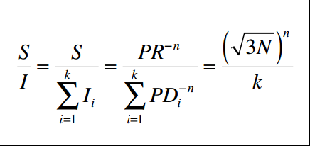
Relation among i, j and N
Reuse Distance : D²= 3R²(i² + j² + ij)
Cell Area : 3 √ 3/2 R²
Cluster Area : √3/2 D²
Cluster Size N=Cluster Area / Cell Area:
N=i² + j² + ij, valid N = 1,3,4,7,12,…
D
j
i
L
R
L = √3/2 . R
MDR = B . Log(1+SNR)

Slide 10
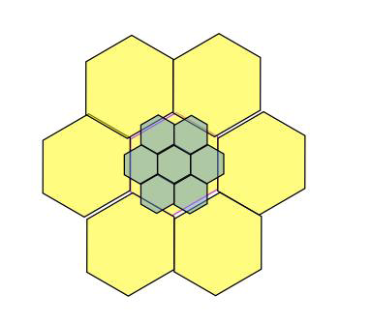
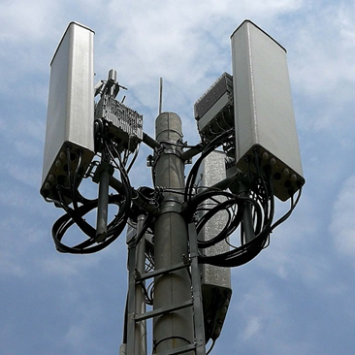
Other Approaches to Increase Capacity
Adding new channels
Frequency borrowing
Cell Splitting
Cell Sectoring

Slide 11
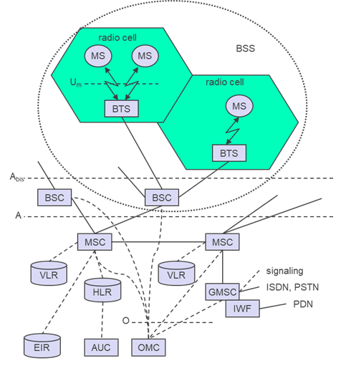
Second Generation Cellular Networks : 2G
Mobile Station (MS)
Mobile Equipment (ME)
Subscriber Identity Module (SIM)
Base Station Subsystem (BSS)
Base Transceiver Station (BTS)
Base Station Controller (BSC)
Network Switching Subsystem(NSS)
Mobile Switching Center (MSC)
Home Location Register (HLR)
Visitor Location Register (VLR)
Authentication Center (AUC)
Equipment Identity Register (EIR)
Cluster
1 set of Frequencies
D²= 3R²N
MDR = B . Log(1+SNR)

Slide 12
Call Setup in 2G
Mobile Terminated Call
Mobile Originated Call
VLR
1: Calling a GSM subscriber
2: Forwarding call to GMSC
3: Signal call setup to HLR
4, 5: Connect with current VLR
6,7: Forward to responsible MSC
8, 9: get current status of MS
10, 11: paging of MS
12, 13: MS answers
14, 15: Security checks
16, 17: Set up connection
1, 2: Connection request
3, 4: Security check
5-8: Check resources (free circuit)
9-10: Set up call
3
4
6
5
PSTN
GMSC
MSC
7
8
2
9
MS
1
BSC
4
10
HLR
VLR
5
8
9
3
6
14
15
calling
station
7
PSTN
GMSC
MSC
1
2
10
10
13
10
16
BSC
BSC
BSC
11
11
11
11
12
17
MS

Slide 13
GSM Authentication
mobile network
SIM
RAND
K_{i}
RAND
RAND
K_{i}
AC
128 bit
128 bit
128 bit
128 bit
Encrypt
Encrypt
SIM
SRES* 32 bit
SRES 32 bit
MSC
SRES* =? SRES
SRES
32 bit
SRES
K_{i}: individual subscriber authentication key SRES: signed response

Slide 14
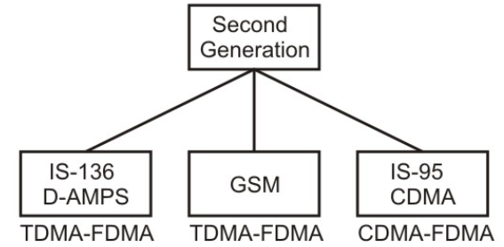
GSM Physical Channel
GSM = FDMA + TDMA
GSM 900 uses 2 Frequency Bands of 25MHz.
890-915MHz for UPLINK and 935-960 MHz for DOWNLINK
Each Band provides 125 Carrier of 200KHz each. 1 Carrier is provided as a Guard Channel between GSM and Other Bands.
Each Carrier uses 8 Time Slots (TS) TDMA
Thus GSM provides 8 * 124 Full Duplex Channel.
Each such Channel (Carrier + TS) is called a Physical Channel.

Slide 15
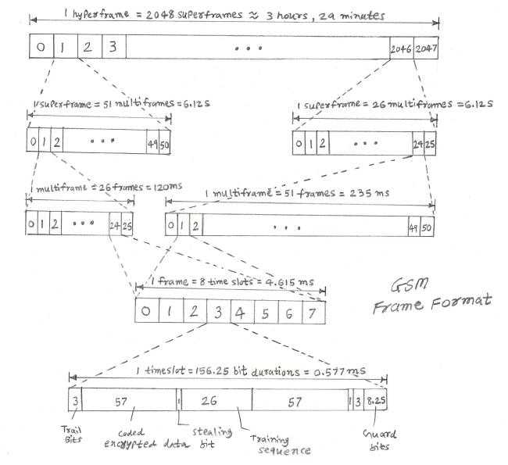
GSM Frame Structure

Slide 16
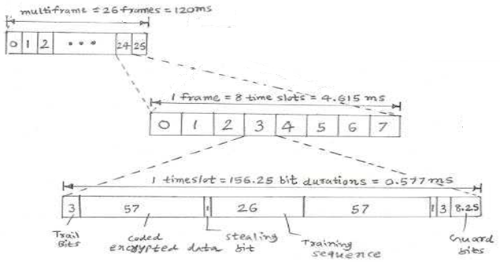
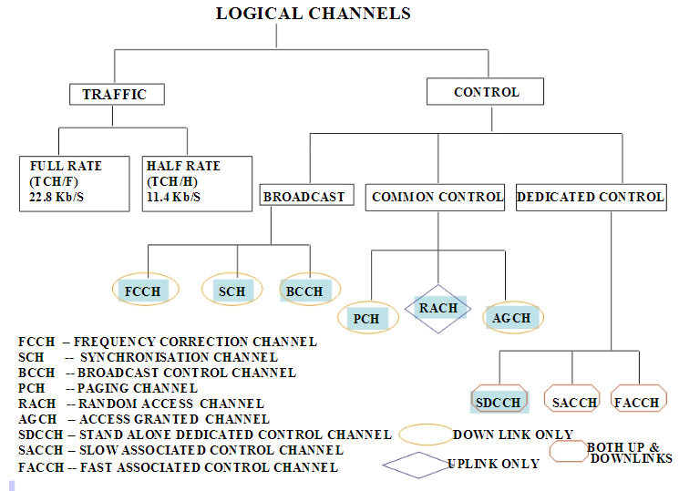
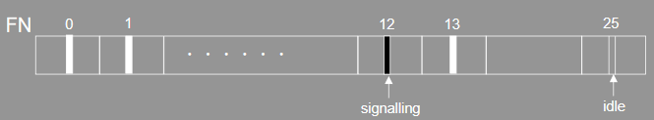
GSM Logical Channel
For Full Rate TCH, FN 12 will be used for signaling while FN 25 is idle
Speed of TCH/F = 24x2x57 bits in 120ms = 22.8kbps
Effective Speed = 13kbps after channel encoding with FEC
For Half rate TCH, FN 12 is signaling and FN 25 is idle for first User while FN 25 is signaling and FN 12 is idle for second User

Slide 17
GSM Logical Channel

Slide 18
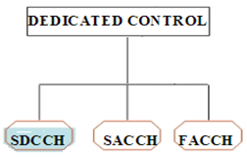
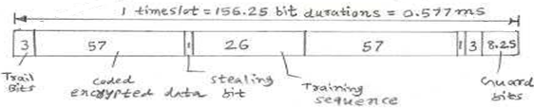
GSM Logical Channel
Slow Associated Control Channel (SACCH) – power control and timing information in the downlink while received signal strength and link quality reports in the uplink.
Fast Associated Control Channel (FACCH) – used to transmit urgent messages e.g. handover. It is sent by steeling 57 bits within a TCH slot.
Standalone Dedicated Control Channel (SDCCH) – used along with SACCH to send and receive messages.

Slide 19
GSM Logical Channel

Slide 20
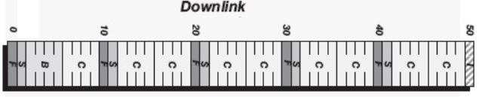
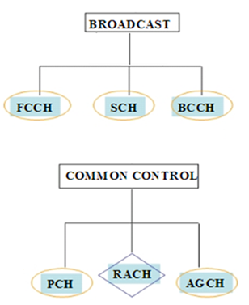
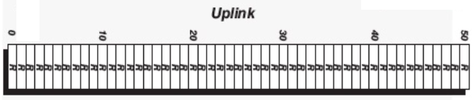
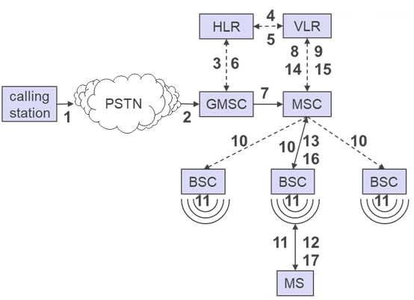
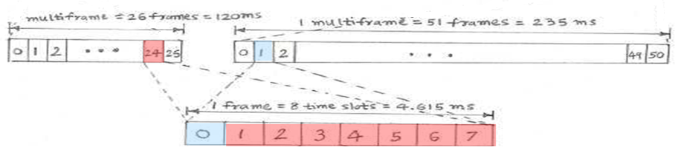
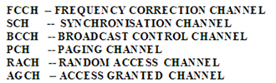
GSM Logical Channel
Communicated in TS 0 of each of the 51 Multiframe

Slide 21
GSM Logical Channel

Slide 22
Questions?
Thank You

